Slide 1
Chapter 11: Correlation
Textbook: Ahmad Daryanto, Introduction to Quantitative Research Methods for Marketing With SPSS and R: Tools and Techniques, Routledge. 2024

Slide 2
Learning Objectives
Understand the concept of covariance and correlation
Know how to interpret a scatter plot
Know how to assess the strength of correlation
Understand the concept of spurious correlation, and partial correlation
Understand the influence of outliers on correlation
Know how to correct correlation for attenuation
Know how to use SPSS and R to conduct correlation analysis

Slide 3
What Is Correlation?
Correlation is a statistical concept to describe a relationship between two variables.
If the two variables are quantitative, the correlation between them can be described by Pearson’s product moment correlation, or Pearson’s correlation for short.
Pearson’s correlation measures linear relationship, which means that a change in one variable relates proportionally to a change in another variable.
Correlation does not imply causation

Slide 4
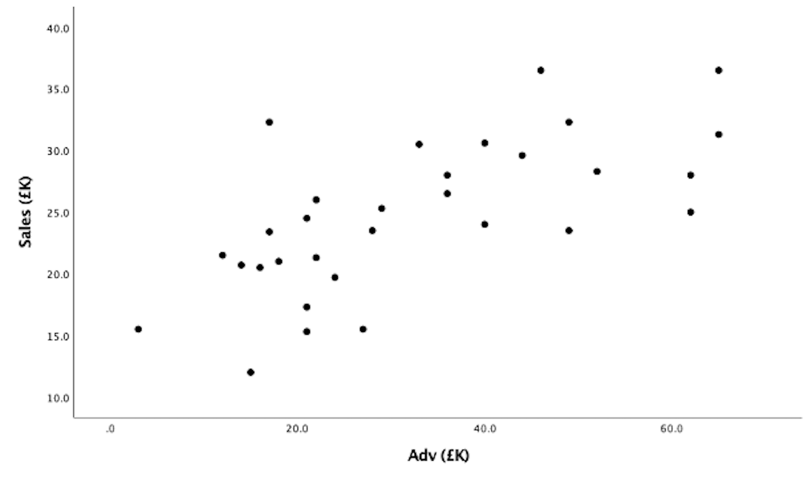
Scatter Plot
If two variables are linearly related, if we plot pair of their values in a coordinate system - the resulting graph is called a scatter plot,

Slide 5
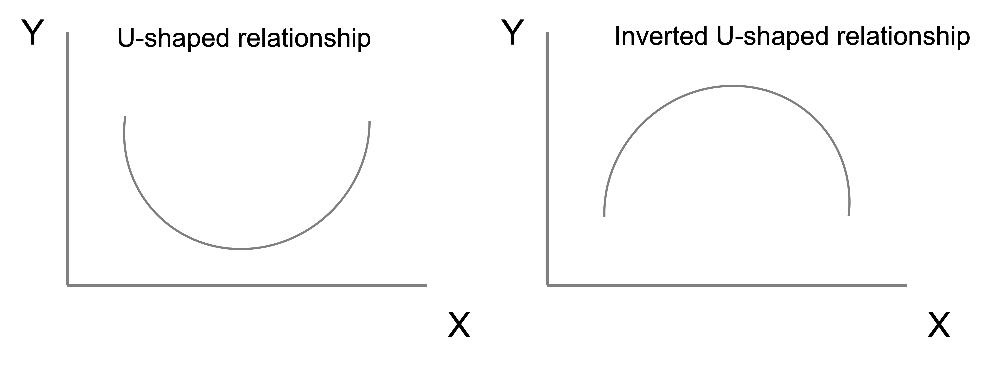
Scatter Plot
In inspecting a scatter plot, there are four points that we need to pay attention to:
1. Form of the relationship suggested by a scatter plot.
2. Direction of the relationship. Are the direction of the points in the scatter plot suggest a negative or a positive relationship, or neither the two?
Brand Switching
A Scatter plot showing a negative correlation
Brand Liking

Slide 6
Scatter Plot
In inspecting a scatter plot, there are four points that we need to pay attention to:
Strength of the relationship. How scattered are the points?
The relationship described by the left graph is stronger than that of the right graph because the points on the left graph is less scattered than those of the right graph.
Sales
Sales
Advertising expenditure
Advertising expenditure

Slide 7
Scatter Plot
In inspecting a scatter plot, there are four points that we need to pay attention to:
Presence of unusual points or outliers. Are there any points that are far from groups of points?
Loyalty
outlier
Satisfaction

Slide 8
Pearson’s Correlation Coefficient
If two quantitative variables have a linear relationship, the strength of the relationship can be described by a Pearson’s correlation coefficient. The symbol for the correlation between two variables in a population is ρ, and the symbol for sample correlation is r.
In this book, correlation coefficient refers to Pearson’s correlation coefficient. ρ or r takes a value between -1 and 1. The sign tells the direction of the relationship where a minus sign tells a negative relationship and a positive sign tells a positive relationship.

Slide 9
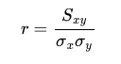
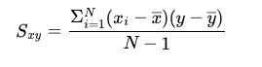
How to Calculate r?
A formula to calculate corelation coefficient r of a sample is given by:
The formula suggests that the sample correlation is the standardized form of the sample covariance. The sample covariance between x and y is given by this formula:

Slide 10
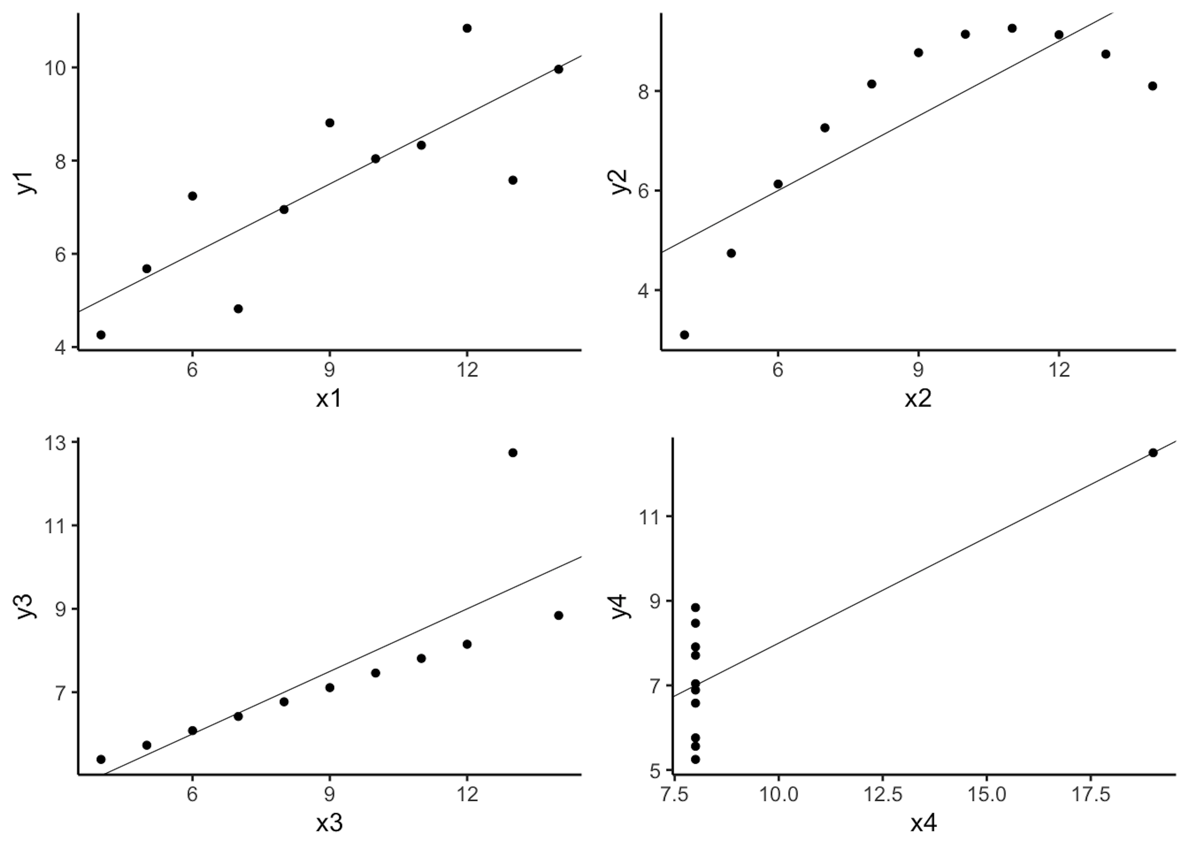
Anscombe Quartet
Anscombe quartet shows four sets of data.
Their correlations are the same although the pattern
of the relationship are not.

Slide 11
Strength of Correlation
Cohen (1988) provides a guideline to assess the strength of correlation between two variables.
r = 0.1 small
r = 0.3 moderate
r = 0.5 strong

Slide 12
SPSS and R Actions
SPSS syntax:
R Script:
CORRELATIONS
/VARIABLES=Sales Adv
/PRINT=TWOTAIL NOSIG FULL
/MISSING=PAIRWISE.
library(haven)
dat <- read_spss("/Users/ahmaddaryanto/Documents/Data1/sales.sav")
library(ggplot2)
p1 <- ggplot(data=dat, aes(x=Adv, y=Sales))+
geom_point() +
labs(x= "Monthly Advertising Expenditure (£K)", y = "Sales") +
theme_classic()
p1
cor(dat$Adv, dat$Sales)

Slide 13
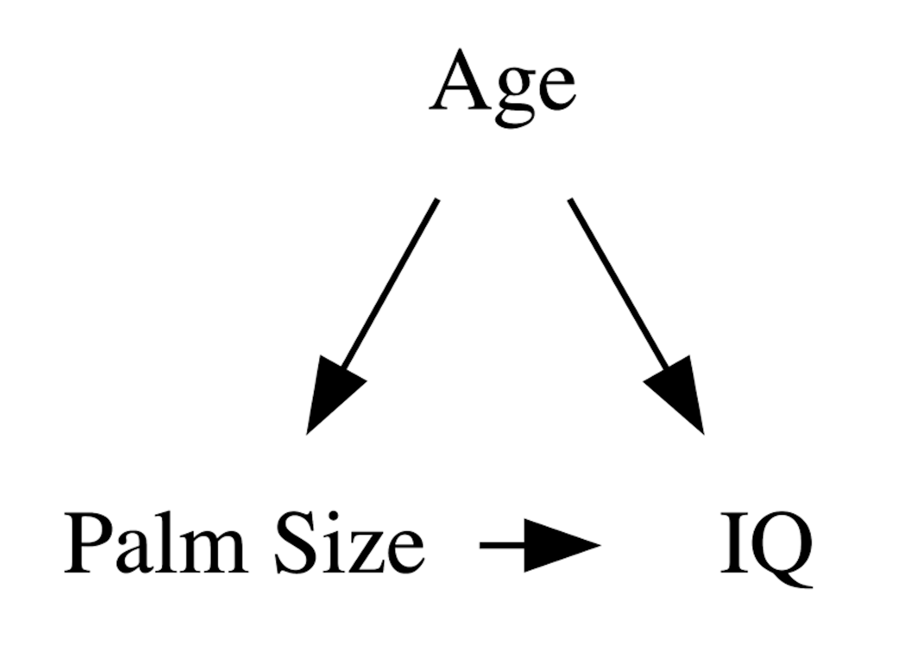
Spurious Correlation
There may be situations where correlation appears to exist even though there is no obvious relationship between the variables. For example, for children who are growing, their intelligence measured with IQ score and palm size might be correlated even though we cannot say IQ causes palm size to be bigger or vice versa. The reason of why IQ and palm size of children below 5 years is correlated because both variables are affected by a common cause, that is age, and age is related to mental development of the children through education. In other words, age is both related to IQ and palm size that makes IQ and palm size to be correlated.

Slide 14
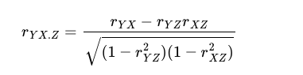
Partial Correlation
If a correlation is suspected to be spurious, the true nature of the correlation can be revealed by calculating a partial correlation.
Suppose that Z is a third variable that exerts its influence on both X and Y,. The idea in partial correlation between X and Y is that the influence of Z on both X and Y are removed in the calculation of the correlation. The partial calculation between X and Y is calculated using this formula:

Slide 15
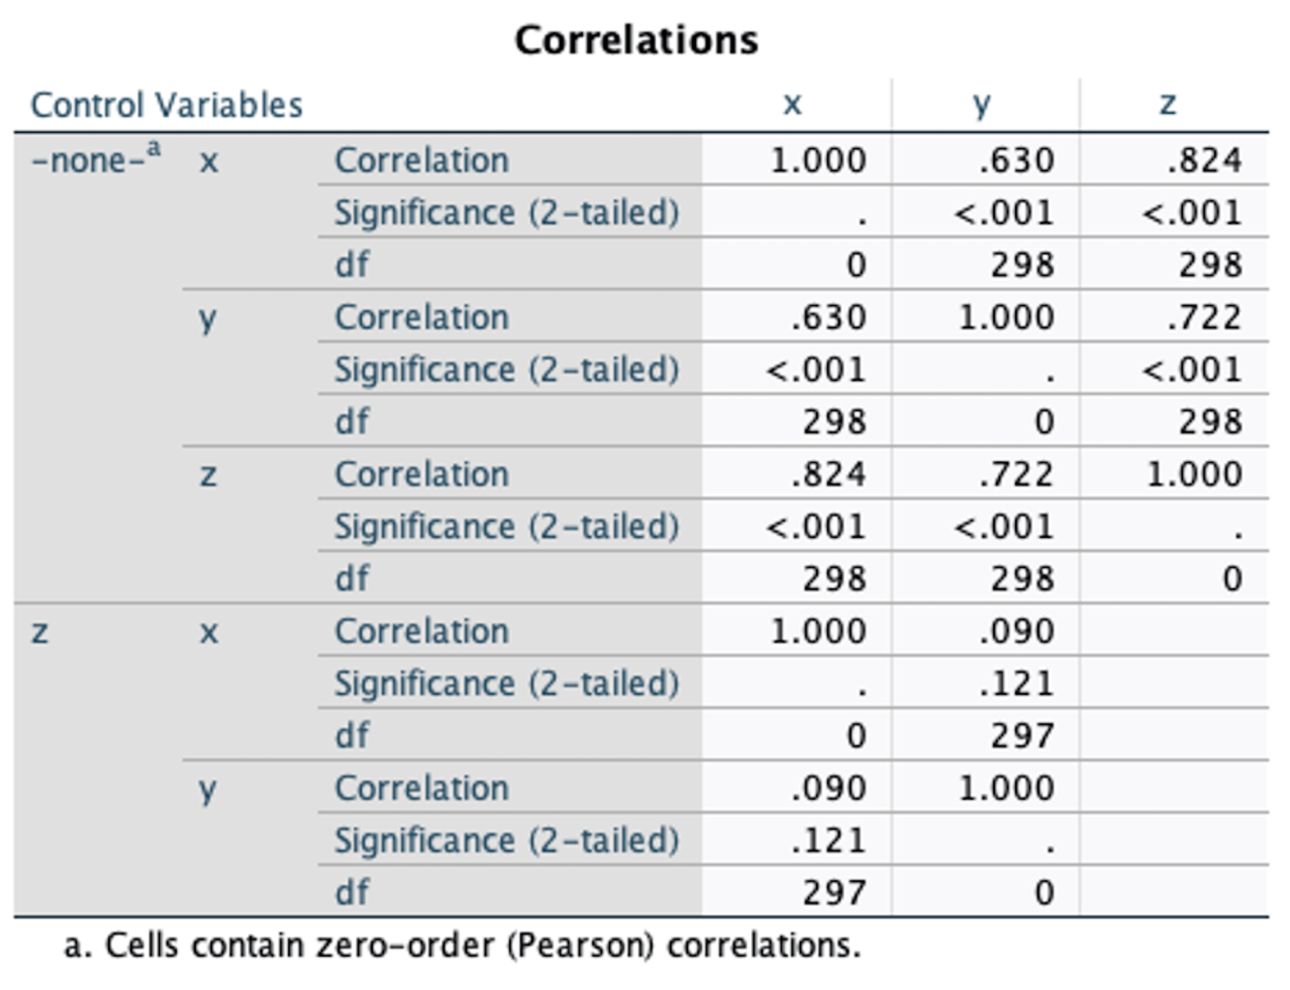
Spurious: SPSS Action
Data: spurious.sav
PARTIAL CORR
/VARIABLES=x y BY z
/SIGNIFICANCE=TWOTAIL
/STATISTICS=CORR
/MISSING=LISTWISE.

Slide 16
Spurious: R Action
Data: spurious.sav
To calculate the partial correlation of two quantitative variables, you can use the pcor.test() function from ppcor. To use pcor.test() function for calculating Pearson’s bivariate partial correlation between x and y controlling for z, it has the form pcor.test(x, y, z, method = "Pearson")
library(haven)
library(ppcor)
dat <- read_sav("/Users/ahmaddaryanto/Documents/Data1/spurious.sav")
pcor.test(dat$x, dat$y, dat$z, method = c("pearson"))

Slide 17
Semipartial Correlation
REGRESSION
/MISSING LISTWISE
/STATISTICS COEFF OUTS R ANOVA ZPP
/CRITERIA=PIN(.05) POUT(.10)
/NOORIGIN
/DEPENDENT y
/METHOD=ENTER x z
/SAVE RESID.
The block of correlation outputs the zero-order correlation, Partial, and Semipartial (part) correlation. For instance, the semipartial correlation between X and Y with Z is removed from X is 0.062. The semipartial correlation of Z and Y with X is removed from Z is 0.358.

Slide 18
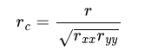
Correction for attenuation
Error in measuring a construct can occur. For example, respondents may not state his or her true opinion due to various reasons. This measurement error can also affect correlation coefficient. The good news is that correlation coefficient can be corrected for attenuation, thus resulting in a true correlation coefficient. The formula for correlation coefficient corrected for attenuation is given by:
where r is correlation coefficient, rxx and ryy are reliability coefficient (Cronbach’s alpha) for x and y, respectively.

Slide 19
Correlation and Covariance Matrix
If there are more than two variables involved, correlation among variables can be represented by a correlation matrix, and for the same variables, the covariance among variables is represented by a covariance matrix.
In the covariance matrix, its main diagonal is occupied by variance terms, and the off-diagonal is made up of the covariance terms.
X | Y | Z
1
0.68 | 1
0.12 | 0.26 | 1
X | Y | Z
1.03
0.79 | 1.32
0.21 | 0.51 | 2.84
Lower-diagonal correlation matrix
Lower-diagonal covariance matrix

Slide 20
Correlation and Covariance Matrix
Data: empathy.sav
R code
library(tidyverse)
library(haven)
dat <- read_sav("/Users/ahmaddaryanto/Documents/Data1/empathy.sav")
dat2 <- dat |>
dplyr::select(MI1, MI2, MI3)
cor.out <- round(cor(dat2),2) # correlation
cov.out <-round(cov(dat2),2) # covariance
cor.out

